Slide 1
Statistics for
Business and Economics 8th Edition
Chapter 2
Describing Data: Numerical

Slide 2
Chapter Goals
After completing this chapter, you should be able to:
Compute and interpret the mean, median, and mode for a set of data
Find the range, variance, standard deviation, and coefficient of variation and know what these values mean
Apply the empirical rule to describe the variation of population values around the mean
Explain the weighted mean and when to use it
Explain how a least squares regression line estimates a linear relationship between two variables

Slide 3
Chapter Topics
Measures of central tendency, variation, and shape
Mean, median, mode, geometric mean
Quartiles
Range, interquartile range, variance and standard deviation, coefficient of variation
Symmetric and skewed distributions
Population summary measures
Mean, variance, and standard deviation
The empirical rule and Chebyshev’s Theorem

Slide 4
Chapter Topics
(continued)
Five number summary and box-and-whisker plots
Covariance and coefficient of correlation
Pitfalls in numerical descriptive measures and ethical considerations

Slide 5
Describing Data Numerically
Describing Data Numerically
Central Tendency
Variation
Arithmetic Mean
Range
Median
Interquartile Range
Mode
Variance
Standard Deviation
Coefficient of Variation

Slide 6
Measures of Central Tendency
2.1
Overview
Central Tendency
Mean
Median
Mode
Arithmetic average
Midpoint of ranked values
Most frequently observed value
(if one exists)

Slide 7
Arithmetic Mean
The arithmetic mean (mean) is the most common measure of central tendency
For a population of N values:
For a sample of size n:
Population values
Population size
Observed values
Sample size

Slide 8
Arithmetic Mean
(continued)
The most common measure of central tendency
Mean = sum of values divided by the number of values
Affected by extreme values (outliers)
0 1 2 3 4 5 6 7 8 9 10
0 1 2 3 4 5 6 7 8 9 10
Mean = 3
Mean = 4

Slide 9
Median
In an ordered list, the median is the “middle” number (50% above, 50% below)
Not affected by extreme values
0 1 2 3 4 5 6 7 8 9 10
0 1 2 3 4 5 6 7 8 9 10
Median = 3
Median = 3

Slide 10
Finding the Median
The location of the median:
If the number of values is odd, the median is the middle number
If the number of values is even, the median is the average of the two middle numbers
Note that is not the value of the median, only the position of the median in the ranked data

Slide 11
Mode
A measure of central tendency
Value that occurs most often
Not affected by extreme values
Used for either numerical or categorical data
There may be no mode
There may be several modes
0 1 2 3 4 5 6 7 8 9 10 11 12 13 14
0 1 2 3 4 5 6
No Mode
Mode = 9

Slide 12
Review Example
Five houses on a hill by the beach
House Prices: $2,000,000 500,000 300,000 100,000 100,000

Slide 13
Review Example: Summary Statistics
House Prices: $2,000,000
500,000 300,000 100,000 100,000
Sum 3,000,000
Mean: ($3,000,000/5)
= $600,000
Median: middle value of ranked data = $300,000
Mode: most frequent value = $100,000

Slide 14
Which measure of location is the “best”?
Mean is generally used, unless extreme values (outliers) exist . . .
Then median is often used, since the median is not sensitive to extreme values.
Example: Median home prices may be reported for a region – less sensitive to outliers

Slide 15
Shape of a Distribution
Describes how data are distributed
Measures of shape
Symmetric or skewed
Left-Skewed
Symmetric
Right-Skewed
Mean < Median
Mean = Median
Median < Mean

Slide 16
Geometric Mean
Geometric mean
Used to measure the rate of change of a variable over time
Geometric mean rate of return
Measures the status of an investment over time
Where x_{i} is the rate of return in time period i

Slide 17
Example
An investment of $100,000 rose to $150,000 at the end of year one and increased to $180,000 at end of year two:
50% increase 20% increase
What is the mean percentage return over time?
Notes:
Calculate the change (subtract old value from the new value).
Divide that change by the old value (you will get a decimal number).
Convert that to a percentage (by multiplying by 100 and adding a "%" sign).
Percentage Change - Math Is Fun
www.mathsisfun.com/numbers/percentage-change.html

Slide 18
Example
(continued)
Use the 1-year returns to compute the arithmetic mean and the geometric mean:
Arithmetic mean rate of return:
Misleading result
Geometric mean rate of return:
Accurate result

Slide 19
Percentiles and Quartiles
Percentiles and Quartiles indicate the position of a value relative to the entire set of data
Generally used to describe large data sets
Example: An IQ score at the 90th percentile means that 10% of the population has a higher IQ score and 90% have a lower IQ score.
P^{th} percentile = value located in the (P/100)(n + 1)^{th}
ordered position

Slide 20
Quartiles
Quartiles split the ranked data into 4 segments with an equal number of values per segment (note that the widths of the segments may be different)
25%
25%
25%
25%
Q₁
Q₂
Q₃
The first quartile, Q₁, is the value for which 25% of the observations are smaller and 75% are larger
Q₂ is the same as the median (50% are smaller, 50% are larger)
Only 25% of the observations are greater than the third quartile

Slide 21
Quartile Formulas
Find a quartile by determining the value in the appropriate position in the ranked data, where
First quartile position: Q₁ = 0.25(n+1)
Second quartile position: Q₂ = 0.50(n+1)
(the median position)
Third quartile position: Q₃ = 0.75(n+1)
where n is the number of observed values

Slide 22
Quartiles
Example: Find the first quartile
Sample Ranked Data: 11 12 13 16 16 17 18 21 22
(n = 9)
Q₁ = is in the 0.25(9+1) = 2.5 position of the ranked data
so use the value half way between the 2nd and 3rd values,
so Q₁ = 12.5

Slide 23
Five-Number Summary
The five-number summary refers to five descriptive measures:
minimum
first quartile
median
third quartile
maximum
minimum < Q₁ < median < Q₃ < maximum

Slide 24
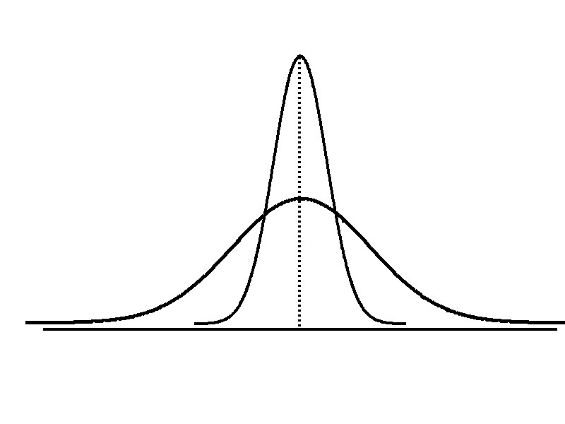
Measures of Variability
2.2
Variation
Range
Interquartile
Range
Variance
Standard Deviation
Coefficient of Variation
Measures of variation give information on the spread or variability of the data values.
Same center,
different variation

Slide 25
Range
Simplest measure of variation
Difference between the largest and the smallest observations:
Range = X_{largest} – X_{smallest}
Example:
0 1 2 3 4 5 6 7 8 9 10 11 12 13 14
Range = 14 - 1 = 13

Slide 26
Disadvantages of the Range
Ignores the way in which data are distributed
Sensitive to outliers
7 8 9 10 11 12
7 8 9 10 11 12
Range = 12 - 7 = 5
Range = 12 - 7 = 5
1,1,1,1,1,1,1,1,1,1,1,2,2,2,2,2,2,2,2,3,3,3,3,4,5
Range = 5 - 1 = 4
1,1,1,1,1,1,1,1,1,1,1,2,2,2,2,2,2,2,2,3,3,3,3,4,120
Range = 120 - 1 = 119

Slide 27
Interquartile Range
Can eliminate some outlier problems by using the interquartile range
Eliminate high- and low-valued observations and calculate the range of the middle 50% of the data
Interquartile range = 3rd quartile – 1st quartile
IQR = Q₃ – Q₁

Slide 28
Interquartile Range
The interquartile range (IQR) measures the spread in the middle 50% of the data
Defined as the difference between the observation at the third quartile and the observation at the first quartile
IQR = Q₃ - Q₁

Slide 29
Box-and-Whisker Plot
A box-and-whisker plot is a graph that describes the shape of a distribution
Created from the five-number summary: the minimum value, Q₁, the median, Q₃, and the maximum
The inner box shows the range from Q₁ to Q₃, with a line drawn at the median
Two “whiskers” extend from the box. One whisker is the line from Q₁ to the minimum, the other is the line from Q₃ to the maximum value

Slide 30
Box-and-Whisker Plot
The plot can be oriented horizontally or vertically
Example:
Median
(Q₂)
X
X
Q₁
Q₃
minimum
maximum
25% 25% 25% 25%
12 30 45 57 70

Slide 31
Population Variance
Average of squared deviations of values from the mean
Population variance:
Where
= population mean
N = population size
x_{i} = i^{th} value of the variable x

Slide 32
Sample Variance
Average (approximately) of squared deviations of values from the mean
Sample variance:
Where
= arithmetic mean
n = sample size
X_{i} = i^{th} value of the variable X

Slide 33
Population Standard Deviation
Most commonly used measure of variation
Shows variation about the mean
Has the same units as the original data
Population standard deviation:

Slide 34
Sample Standard Deviation
Most commonly used measure of variation
Shows variation about the mean
Has the same units as the original data
Sample standard deviation:

Slide 35
Calculation Example: Sample Standard Deviation
Sample Data (x_{i}) : 10 12 14 15 17 18 18 24
n = 8 Mean = x = 16
A measure of the “average” scatter around the mean

Slide 36
Measuring variation
Small standard deviation
Large standard deviation

Slide 37
Comparing Standard Deviations
Mean = 15.5 for each data set
s = 3.338
(compare to the two cases below)
11 12 13 14 15 16 17 18 19 20 21
Data A
s = 0.926
(values are concentrated near the mean)
11 12 13 14 15 16 17 18 19 20 21
Data B
s = 4.570
(values are dispersed far from the mean)
11 12 13 14 15 16 17 18 19 20 21
Data C

Slide 38
Advantages of Variance and Standard Deviation
Each value in the data set is used in the calculation
Values far from the mean are given extra weight (because deviations from the mean are squared)

Slide 39
Using Microsoft Excel
Descriptive Statistics can be obtained from Microsoft® Excel
Select: data / data analysis / descriptive statistics
Enter details in dialog box

Slide 40
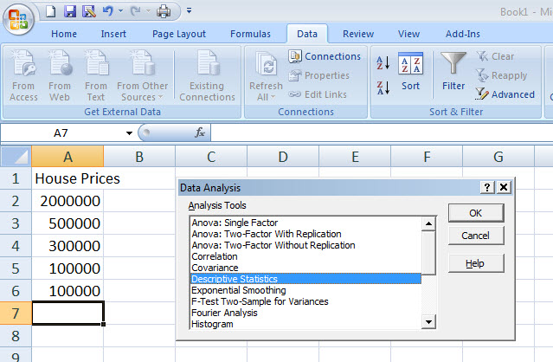
Using Excel
Select data / data analysis / descriptive statistics

Slide 41
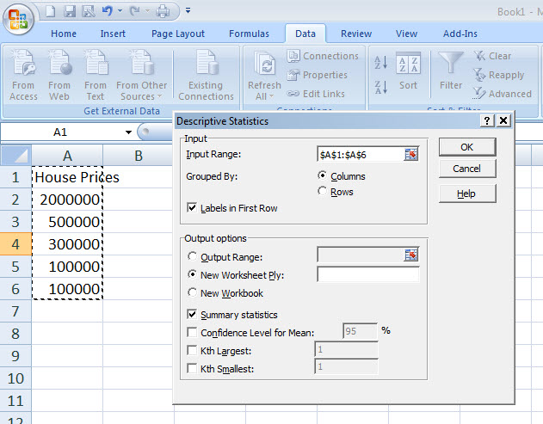
Using Excel
Enter input range details
Check box for summary statistics
Click OK

Slide 42
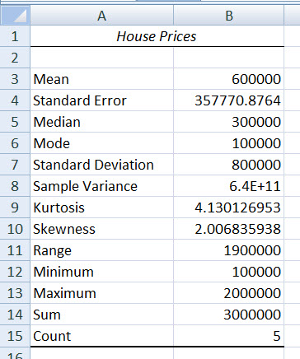
Excel output
Microsoft Excel
descriptive statistics output,
using the house price data:
House Prices: $2,000,000
500,000 300,000 100,000 100,000

Slide 43
Coefficient of Variation
Measures relative variation
Always in percentage (%)
Shows variation relative to mean
Can be used to compare two or more sets of data measured in different units
Population coefficient of variation:
Sample coefficient of variation:

Slide 44
Comparing Coefficient of Variation
Stock A:
Average price last year = $50
Standard deviation = $5
Stock B:
Average price last year = $100
Standard deviation = $5
Both stocks have the same standard deviation, but stock B is less variable relative to its price

Slide 45
Chebychev’s Theorem
For any population with mean μ and standard deviation σ , and k > 1 , the percentage of observations that fall within the interval
[μ + kσ]
Is at least

Slide 46
Chebychev’s Theorem
(continued)
Regardless of how the data are distributed, at least (1 - 1/k²) of the values will fall within k standard deviations of the mean (for k > 1)
Examples:
(1 - 1/1.5²) = 55.6% ……... k = 1.5 (μ ± 1.5σ)
(1 - 1/2²) = 75% …........... k = 2 (μ ± 2σ)
(1 - 1/3²) = 89% …….…... k = 3 (μ ± 3σ)
At least
within

Slide 47
The Empirical Rule
If the data distribution is bell-shaped, then the interval:
contains about 68% of the values in the population or the sample
68%

Slide 48
The Empirical Rule
(continued)
contains about 95% of the values in
the population or the sample
contains almost all (about 99.7%) of the values in the population or the sample
95%
99.7%

Slide 49
z-Score
A z-score shows the position of a value relative to the mean of the distribution.
indicates the number of standard deviations a value is from the mean.
A z-score greater than zero indicates that the value is greater than the mean
a z-score less than zero indicates that the value is less than the mean
a z-score of zero indicates that the value is equal to the mean.

Slide 50
z-Score
(continued)
If the data set is the entire population of data and the population mean, µ, and the population standard deviation, σ, are known, then for each value, x_{i}, the z-score associated with x_{i} is

Slide 51
z-Score
(continued)
If intelligence is measured for a population using an IQ score, where the mean IQ score is 100 and the standard deviation is 15, what is the z-score for an IQ of 121?
A score of 121 is 1.4 standard deviations above the mean.

Slide 52
Weighted Mean and Measures of Grouped Data
2.3
The weighted mean of a set of data is
Where w_{i} is the weight of the i^{th} observation
and
Use when data is already grouped into n classes, with w_{i} values in the i^{th} class

Slide 53
Approximations for Grouped Data
Suppose data are grouped into K classes, with frequencies f₁, f₂, . . ., f_{K}, and the midpoints of the classes are m₁, m₂, . . ., m_{K}
For a sample of n observations, the mean is

Slide 54
Approximations for Grouped Data
Suppose data are grouped into K classes, with frequencies f₁, f₂, . . ., f_{K}, and the midpoints of the classes are m₁, m₂, . . ., m_{K}
For a sample of n observations, the variance is

Slide 55
Measures of Relationships Between Variables
2.4
Two measures of the relationship between variable are
Covariance
a measure of the direction of a linear relationship between two variables
Correlation Coefficient
a measure of both the direction and the strength of a linear relationship between two variables

Slide 56
Covariance
The covariance measures the strength of the linear relationship between two variables
The population covariance:
The sample covariance:
Only concerned with the strength of the relationship
No causal effect is implied

Slide 57
Interpreting Covariance
Covariance between two variables:
Cov(x,y) > 0 x and y tend to move in the same direction
Cov(x,y) < 0 x and y tend to move in opposite directions
Cov(x,y) = 0 x and y are independent

Slide 58
Coefficient of Correlation
Measures the relative strength of the linear relationship between two variables
Population correlation coefficient:
Sample correlation coefficient:

Slide 59
Features of Correlation Coefficient, r
Unit free
Ranges between –1 and 1
The closer to –1, the stronger the negative linear relationship
The closer to 1, the stronger the positive linear relationship
The closer to 0, the weaker any positive linear relationship

Slide 60
Scatter Plots of Data with Various Correlation Coefficients
Y
Y
Y
X
X
X
r = -1
r = -.6
r = 0
Y
Y
Y
X
X
X
r = +1
r = +.3
r = 0

Slide 61
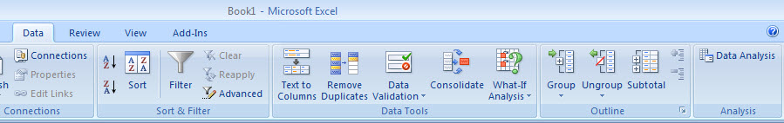
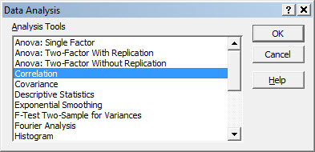
Using Excel to Find the Correlation Coefficient
Select Data / Data Analysis
Choose Correlation from the selection menu
Click OK . . .

Slide 62
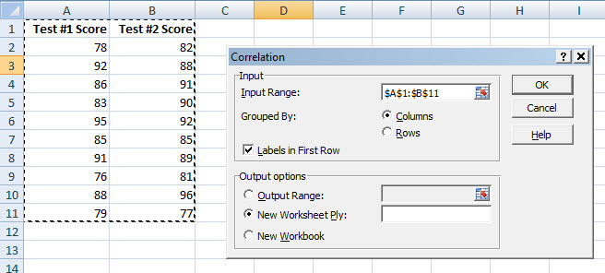

Using Excel to Find the Correlation Coefficient
(continued)
Input data range and select appropriate options
Click OK to get output

Slide 63
Interpreting the Result
r = .733
There is a relatively
strong positive linear
relationship between
test score #1
and test score #2
Students who scored high on the first test tended to score high on second test

Slide 64
Chapter Summary
Described measures of central tendency
Mean, median, mode
Illustrated the shape of the distribution
Symmetric, skewed
Described measures of variation
Range, interquartile range, variance and standard deviation, coefficient of variation
Discussed measures of grouped data
Calculated measures of relationships between variables
covariance and correlation coefficient

Slide 65

All rights reserved. No part of this publication may be reproduced, stored in a retrieval system, or transmitted, in any form or by any means, electronic, mechanical, photocopying, recording, or otherwise, without the prior written permission of the publisher.
Printed in the United States of America.

